Slide 1


Project name: Multi-Axis Cobot For Factory Automation
Team members: Adrian Guzman, Emily Hamsa, Ethan Woods, Jaishil Shah

Slide 2

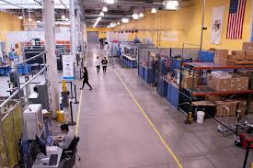
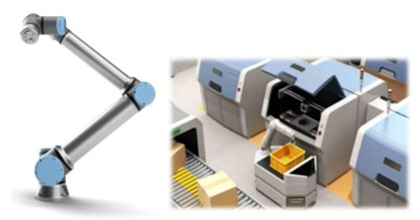
Project Description
Problem statement:
Factory settings pose dangerous environments to human workers through the exposure to heavy machinery, tight spaces, and repetitive workloads. These hazards increase chance of injury and worker burnout. We need to implement collaborative robots (Cobots) to improve worker conditions.
Human Injury & Burnout in Warehouses
Cobot Solution

Slide 3
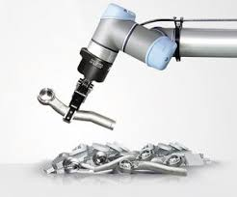
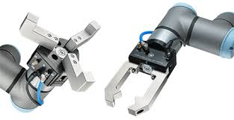
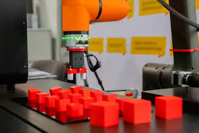
Project Description
Solution proposal:
Develop a Cobot that can integrate into a factory environment to reduce human injury, worker burnout, and increase productivity in repetitive tasks. The Cobot shall be able to lift (1-2lbs) and be placed into tight environments and controlled wirelessly through mobile app.
Precise Control
Repetitive Tasks
1-2 lbs. Load

Slide 4
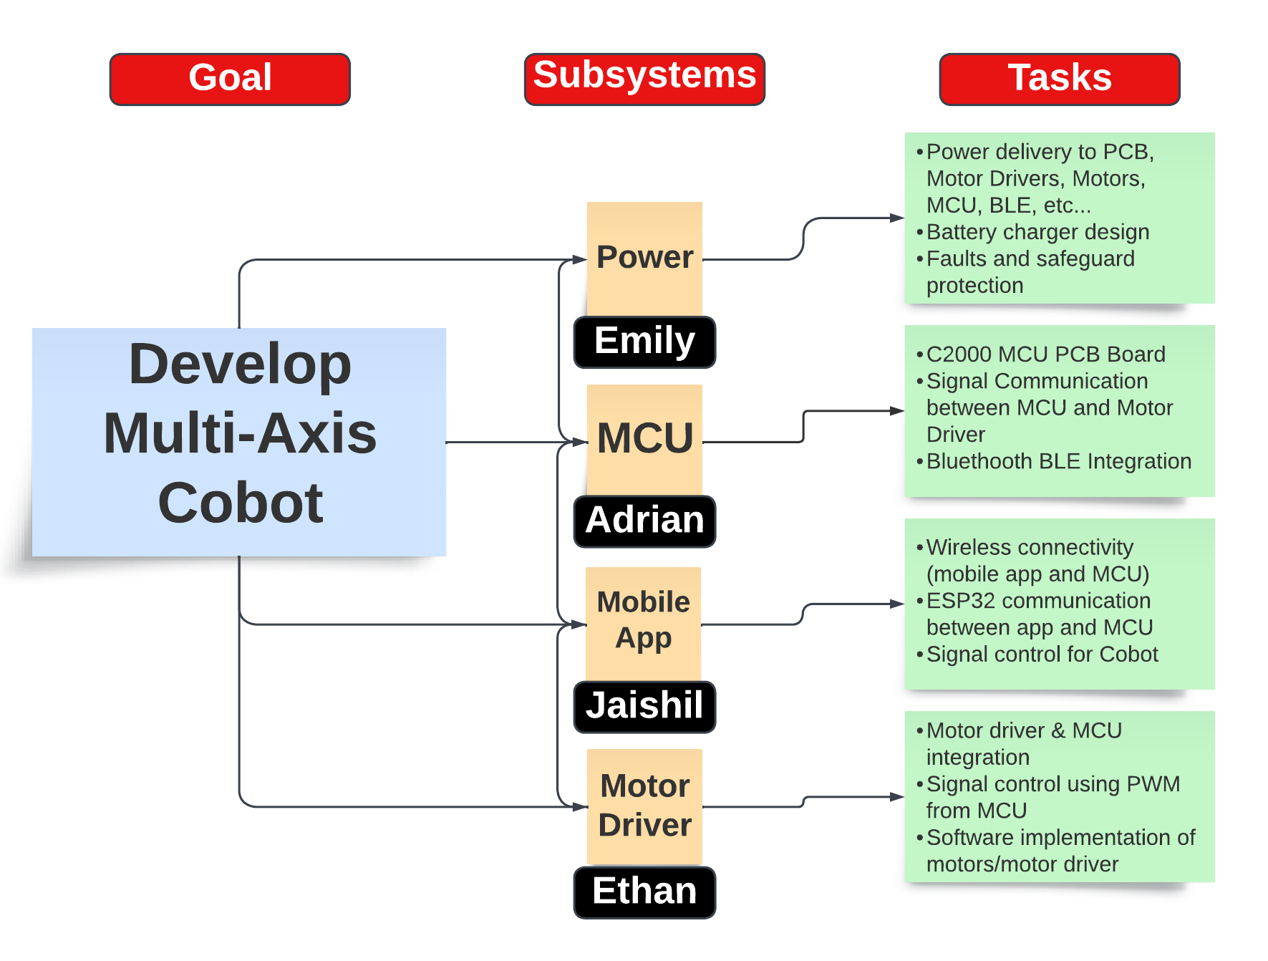
Subsystem Division
Subsystem Intro Projects:
i) Microcontroller
Adrian Guzman
ii) Electronic Circuits
Emily Hamsa
Ethan Woods
iii) Application Development
Jaishil Shah

Slide 5
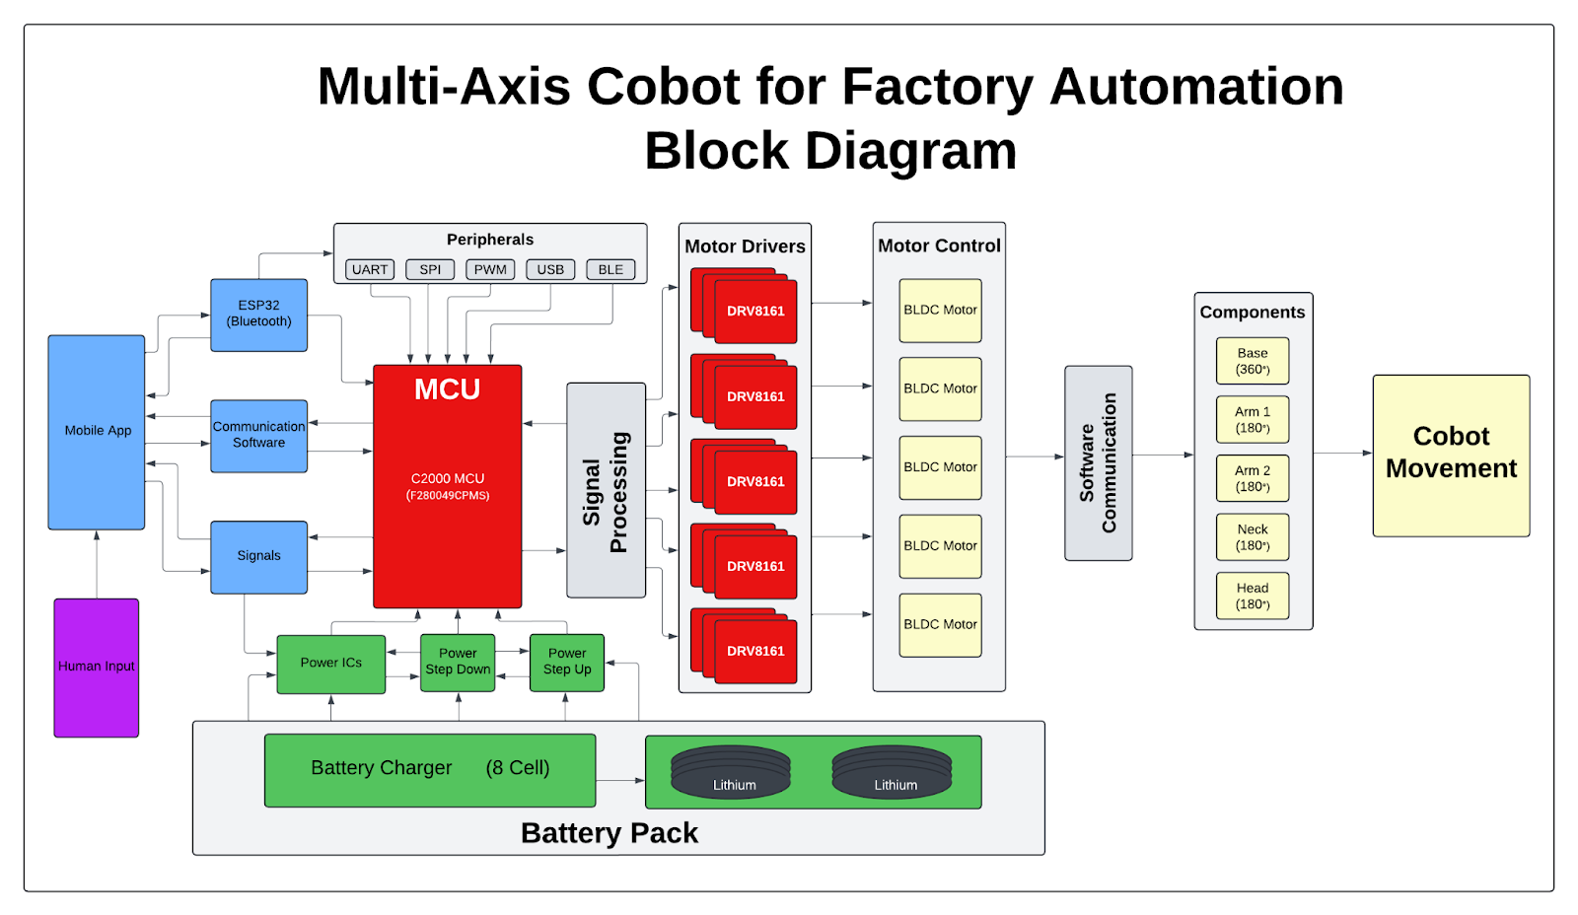
Diagram of subsystems and interface
Subsystem Diagram Color: Power, MCU/Connectivity, Mobile App, Motor Control

Slide 6
Task partition
Adrian:
MCU & processing subsystem, which includes creating PCB with MCU, ESP32 Bluetooth, and integration with motor driver subsystem.
Ethan:
Motor driving subsystem, which includes creating a PCB with motor drivers for motor, communication with MCU, and motor motion.
Emily:
Power and battery management subsystem, which includes the respective PCBs for the PMS and the battery charging system.
Jaishil:
Wireless connectivity and interface subsystem, which includes the mobile application development and communication signal sending.
*Each team member will hold a 25% share in physical design of Cobot

Slide 7
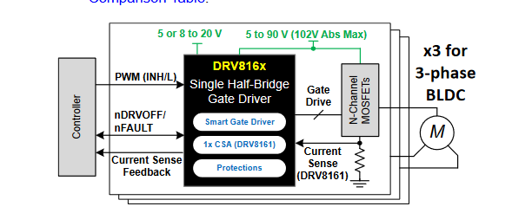
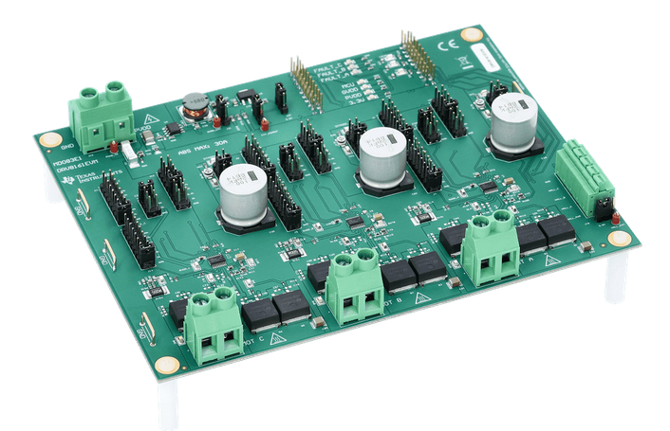
Motor/Motor Driver Subsystem
Ethan
This subsystem harbors the movement of mixed strength Brushless DC (BLDC) Motors using TI’s DRV8161 Motor Drivers.
The DRV8161 can drive higher voltages, which increases the quality and strength of the motors we can use.
Deliverable: Precise Motor control with C2000 MCU through the DRV8161 Motor Drivers
Software used: Altium, TI Cloud Agent (DRV8161 GUI), CCS, C2000 Ware
Motor Breakdown (5 Degrees of Freedom):
360° Rotation at the Base
Two 135°* (TBD) Up and Down Arm Movement
360° Head Rotation
Current Progress:
Researching and Deciding Motors to Use
Started learning and working with Altium
Next Goal: Complete Introduction Project and Decide Motors
DRV816x Simple Schematic
DRV8161 EVM Board

Slide 8
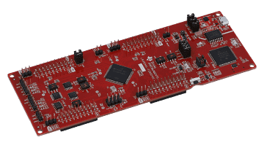
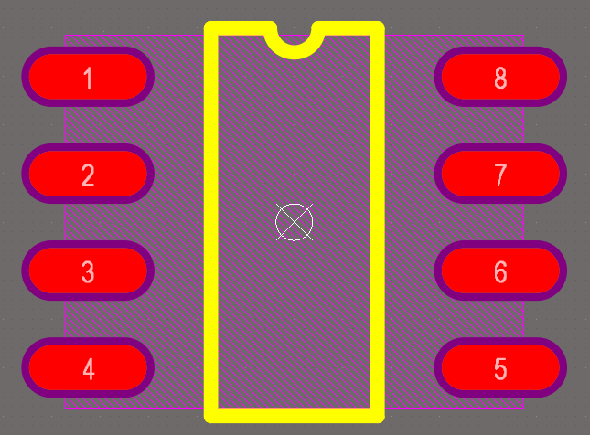
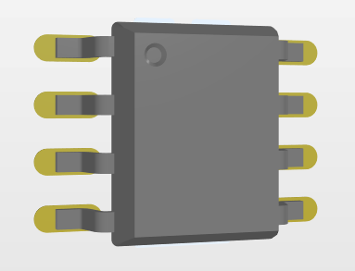
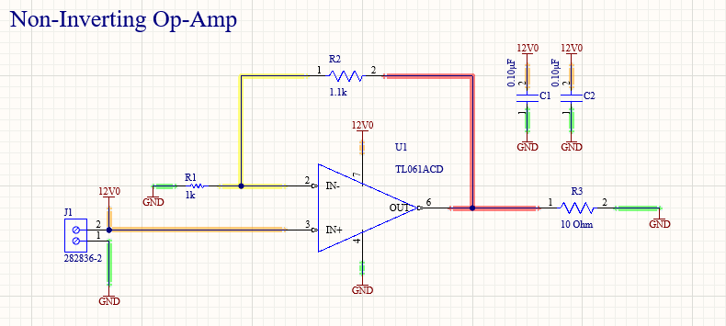
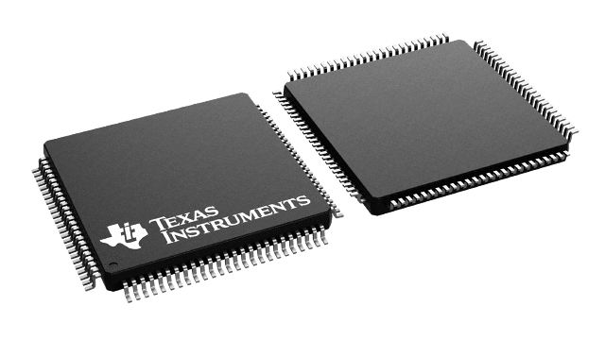
MCU/Processing Subsystem
Adrian
Subsystem Deliverable: PCB that integrates MCU, motor drivers, and ESP 32
Demo: Showcase MCU control with blinking LED (program & flash MCU)
Software: Altium, C2000 Ware, CCS
MCU: F280049CPZS (100pin LQFP 0.3mm pad size x 0.5mm pitch)
16 ePWM channels (3x PWM per BLDC motor -> 1 per phase)
40 GPIO pins (required for ESP32, fault, enable/disable)
Current Progress:
Schematic & PCB footprint library on Altium
Non-inverting op-amp on Altium (Schematic and PCB) for subsystem introduction project.
Next Steps:
Begin schematic design on Altium
Use C2000 EVM to understand control for MCU
C2000 EVM
2D & 3D Footprint
Intro Project Schematic
F280049CPZS MCU

Slide 9
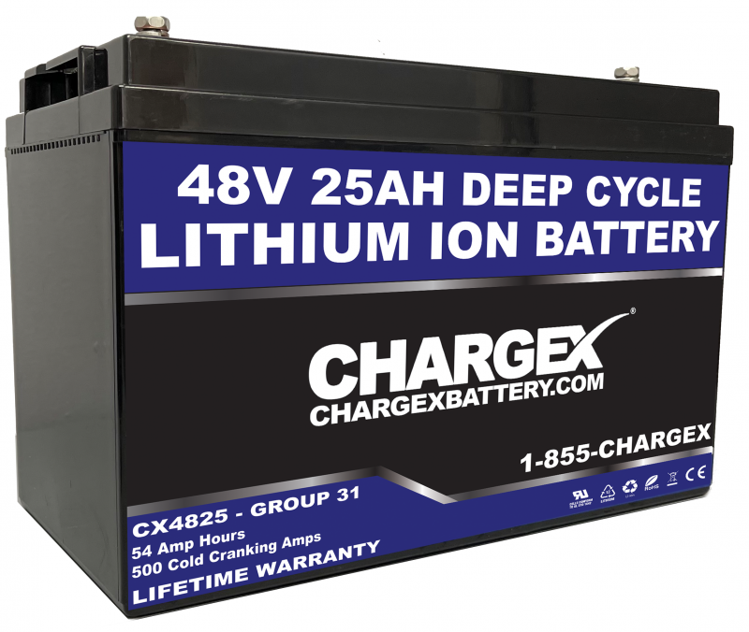

Power and Battery Management Subsystem
Emily
This subsystem will require working closely with teammates to determine
specifications for the Cobots power and runtime needs
Completing a load-list to determine the voltage size of the battery
Discuss desired run-time of the Cobot on one charge to determine the
Amp-hours needed.
Will use Webench to determine best components for the system
Software: Altium, TI Webench
Power Management System PCB:
Stepdown voltage
Regulate voltage and implement system protection
Battery Management and Charging PCB:
Develop a charging PCB for the battery
Implement cell balancing system for multi-cell battery
Subsystem Introduction Project: Electronic Circuit
Deliverable for 403:
PCB that takes power supply input from a battery and steps it down to various voltages

Slide 10
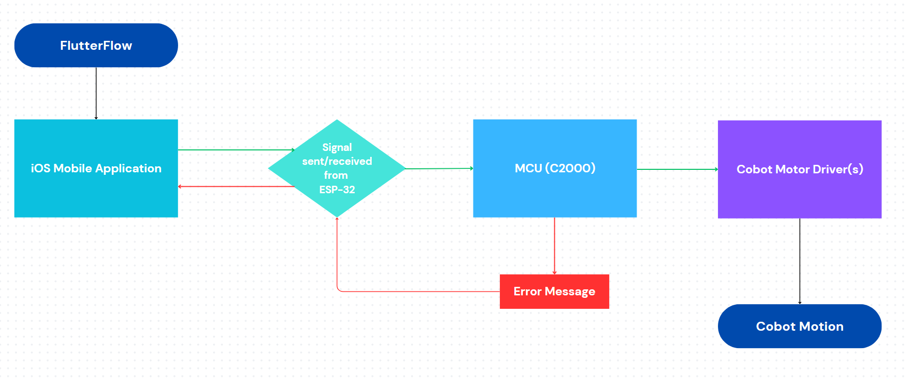

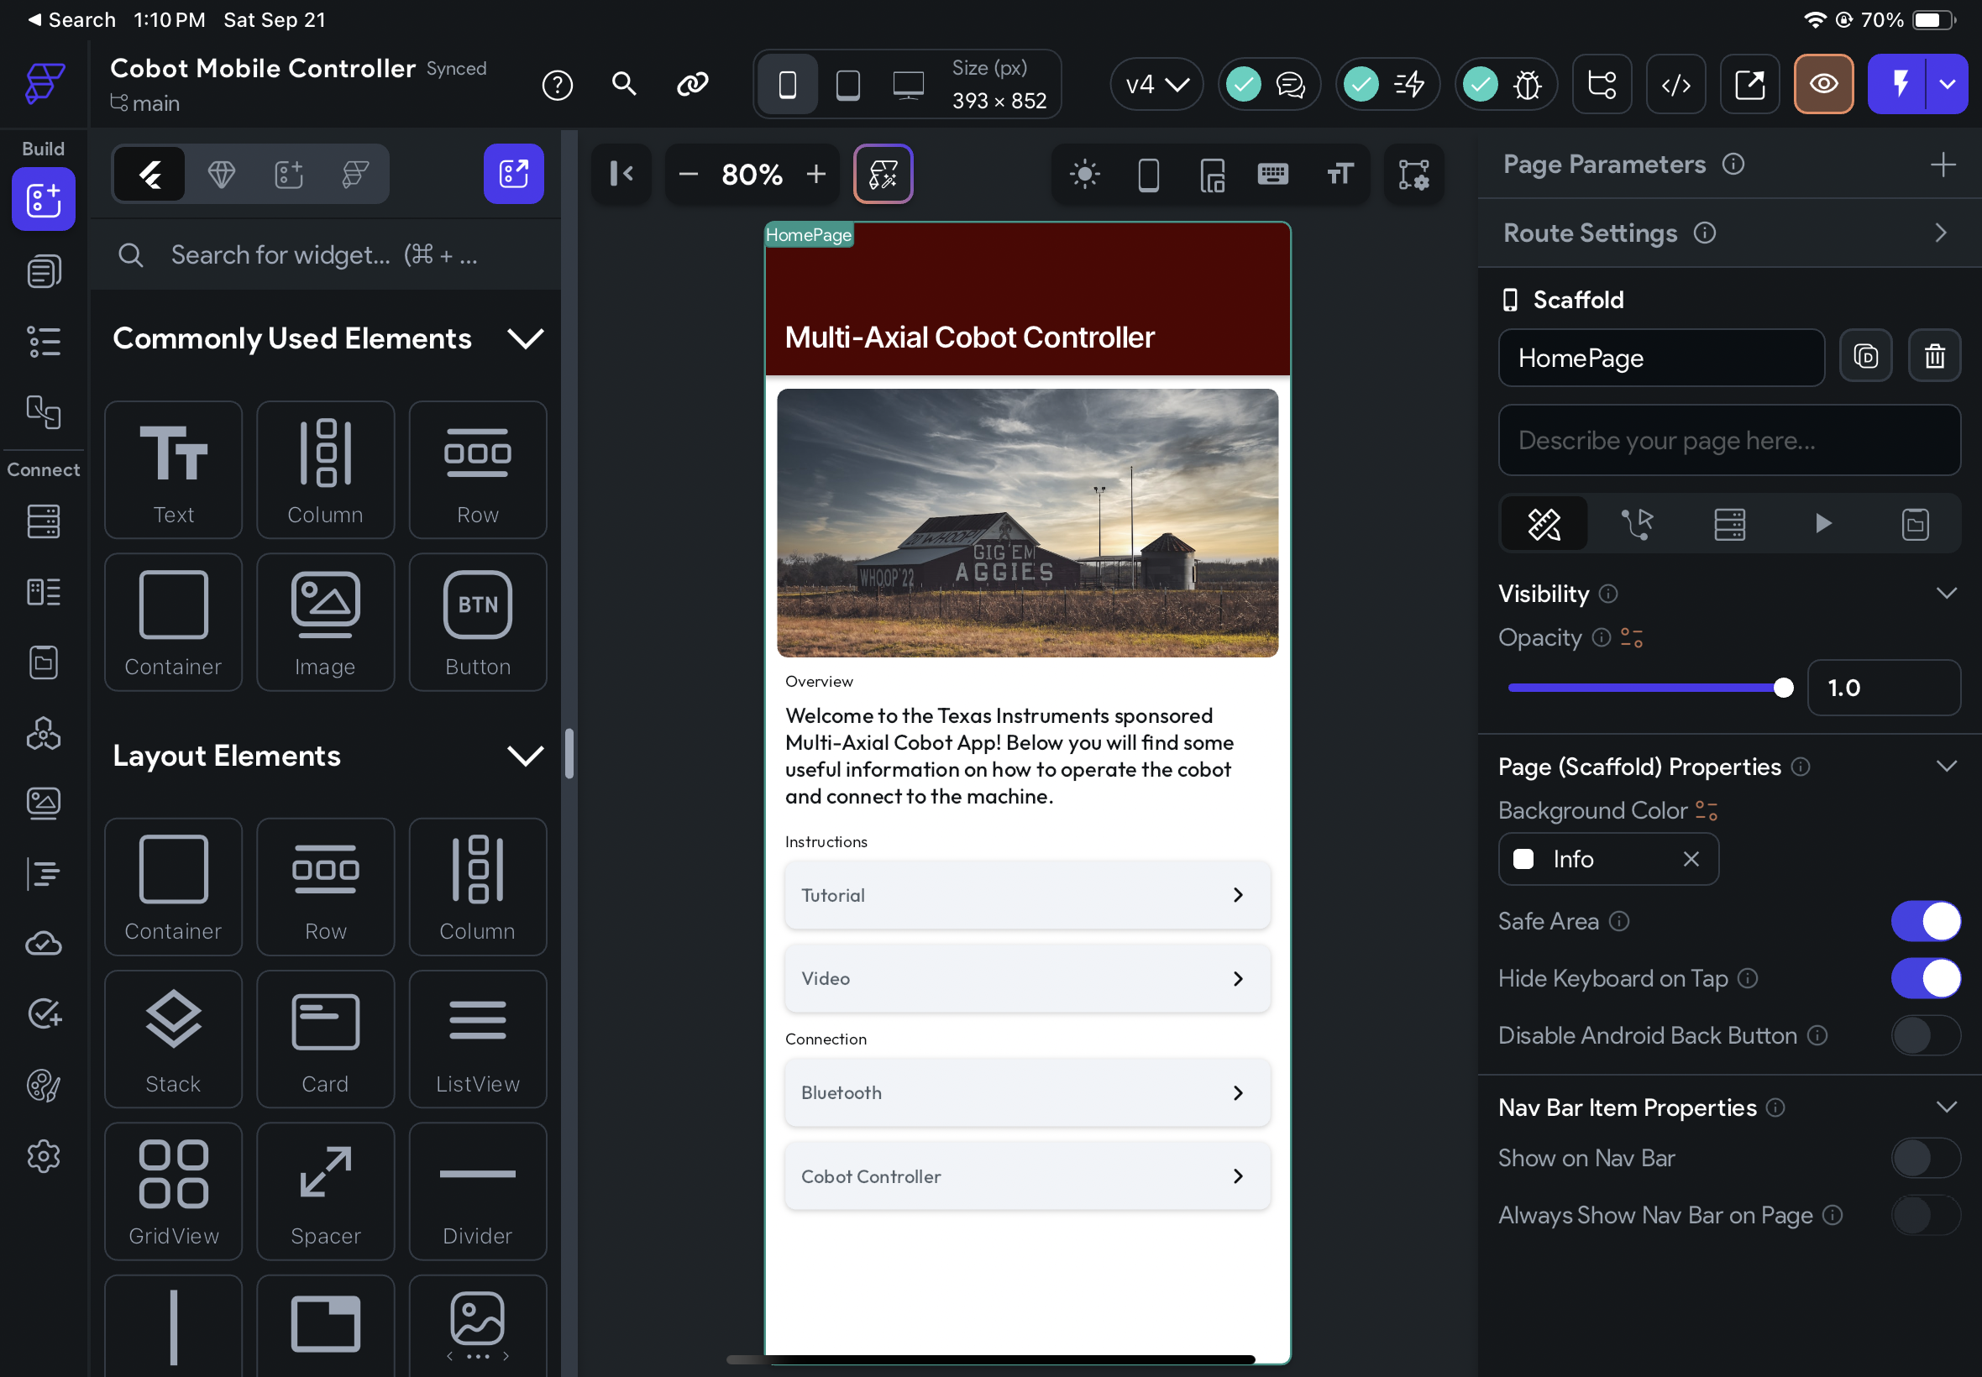
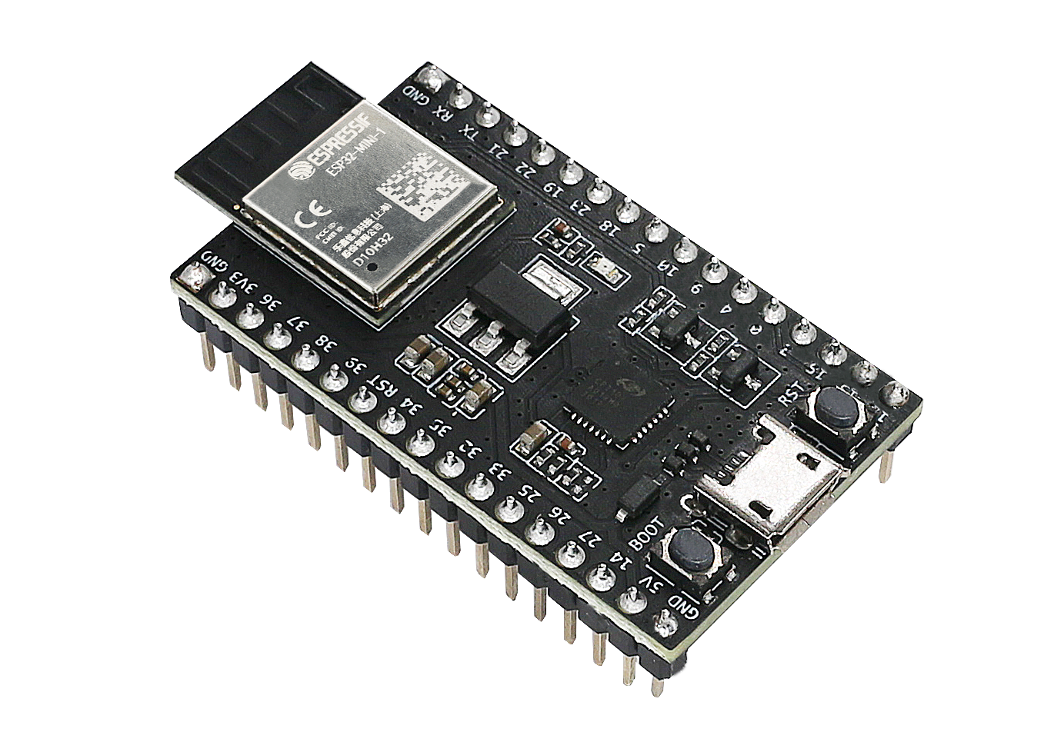
Mobile Application / Wireless Connectivity
Jaishil
Software:
FlutterFlow, C2000 Ware, Altium
Mobile Application:
iOS compatible (iPad/iPhone)
Connected via Bluetooth (ESP-32)
Wireless Connectivity:
IOS --> ESP-32 --> C2000 MCU
*reverse functionality as well
Subsystem Integration
Subsystem Parts:
User Interface
Wireless Communication
- The UI will be able to send and receive signals to a PCB/ESP-32, which is from there able to communicate directly with the MCU.
- The MCU must be able to detect if misinputs or errors are present and send messages back.
FlutterFlow
MacOS / iOS
ESP-32 Bluetooth Driver
Mobile Application Creation

Slide 11
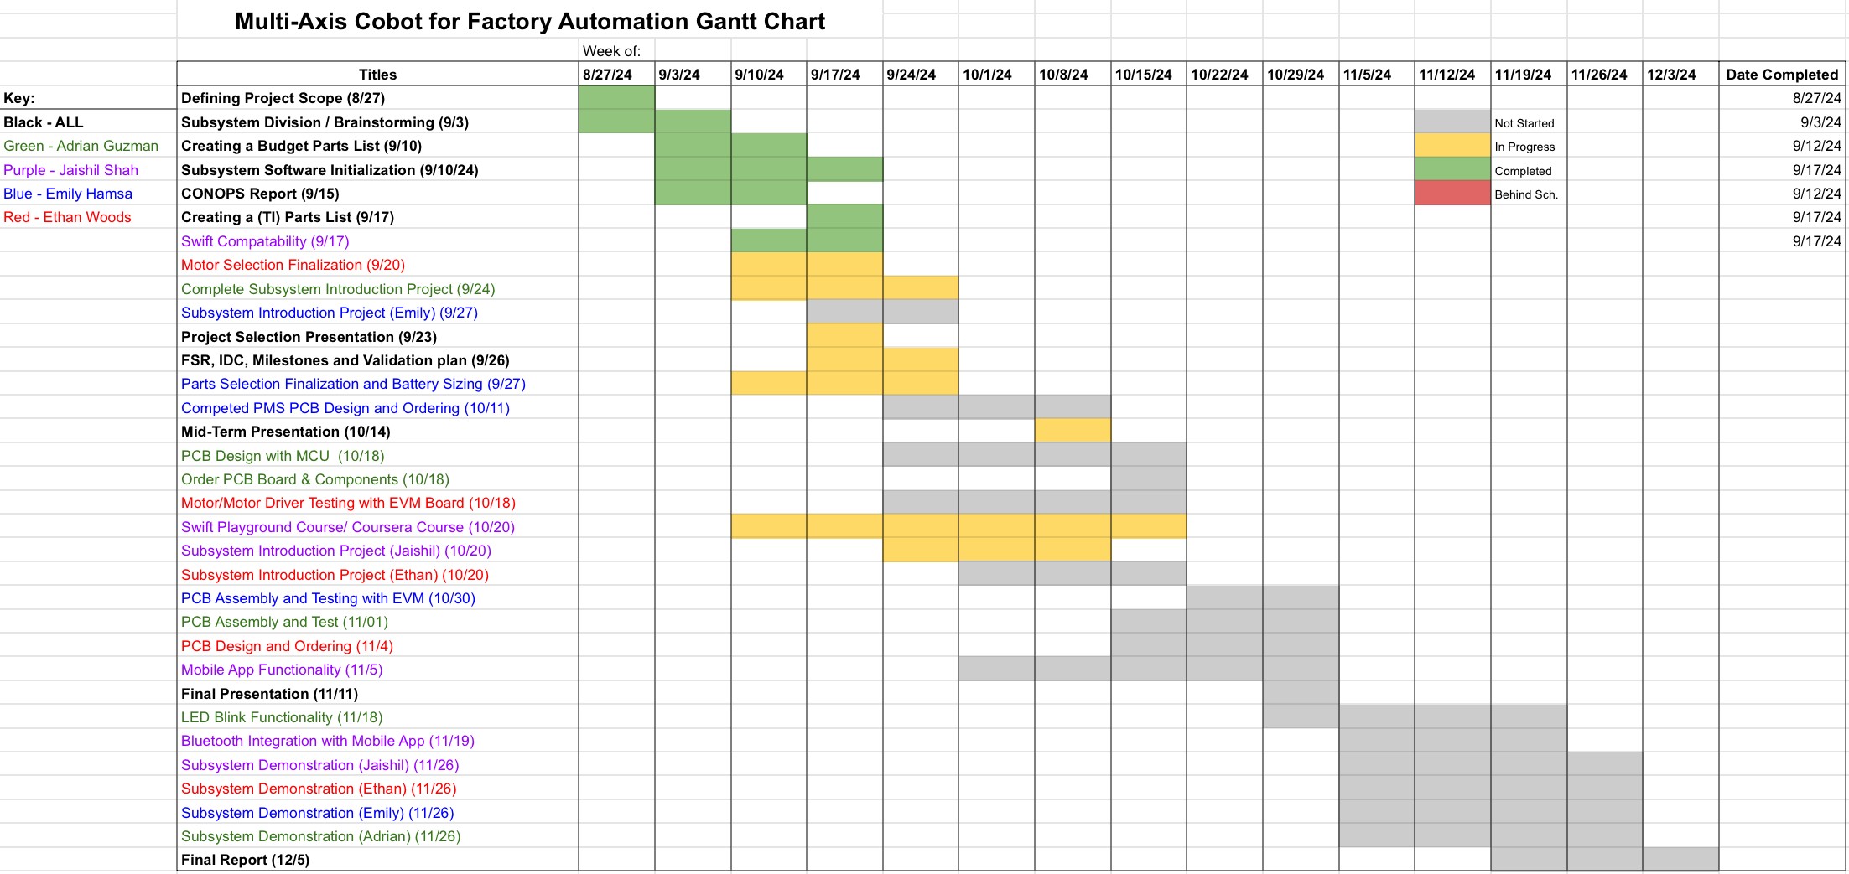
Execution plan

Slide 12
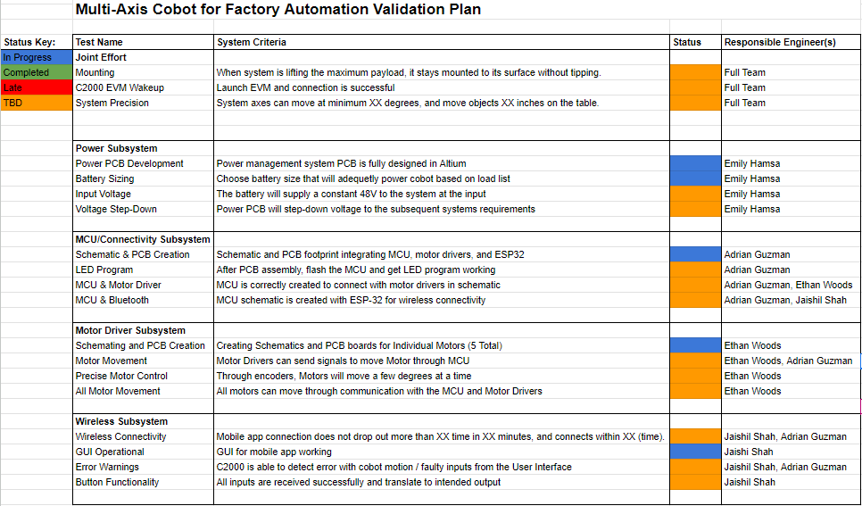
Validation plan

